Slide 1

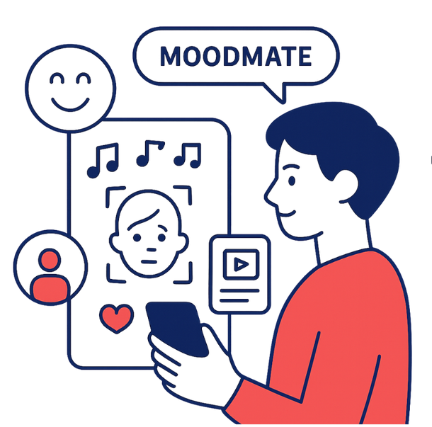
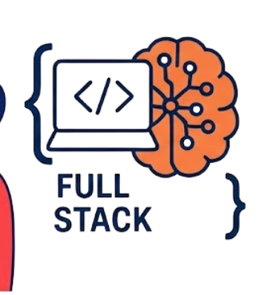
MOODMATE
Don't just listen. Feel the music.
PROJECT
MOODMATE
Presented By: RANIT DERIA

Slide 2

MOODMATE
page 2 of 16
03
PROJECT OVERVIEW
10
TRAINING & EVALUATION
04
DATASET ARCHITECTURE
11
RESULTS COMPARISON
05
METHODOLOGY & PIPELINE
12
SYSTEM INTEGRATION (UI)
TABLE OF CONTENTS
06
EXPLORATORY DATA ANALYSIS
13
CHALLENGES & SOLUTIONS
07
DATA PREPROCESSING
14
FUTURE SCOPE
08
FEATURE EXTRACTION
15
CONCLUSION
09
MODEL ARCHITECTURE
16
THANK YOU
www.tinyurl.com/moodmate

Slide 3
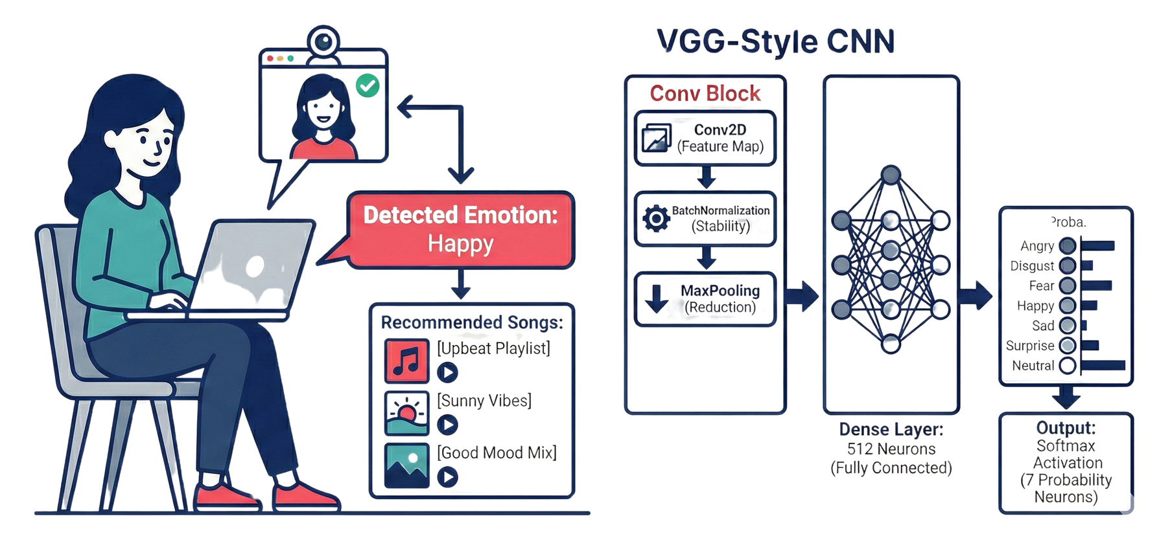
MOODMATE
page 3 of 16
Objective: To architect a Full-Stack application that automatically detects a user's emotional state via computer vision and curates a personalized music playlist in real-time.
The Problem & Solution: Traditional music apps require manual inputs, such as searching for "sad songs". MoodMate digitizes intuition, using facial micro-expressions to automate the music discovery process.
Key Outcomes:
Real-Time Inference
Dynamic Mapping
Cinematic UX
PORJECT OVERVIEW
www.tinyurl.com/moodmate

Slide 4
MOODMATE
page 4 of 16
MoodMate leverages a Dual-Dataset Architecture
Vision Data: FER-2013
Structure: 48 x 48 pixel grayscale images.
Size: ~35,887 labeled images.
Classes: 7 Emotions (Angry, Disgust, Fear, Happy, Sad, Surprise, Neutral).
Audio Data: Spotify Tracks Dataset
Size: ~30,000 tracks.
Key Features: Valence (Musical Positivity), Energy, Danceability.
DATASET ARCHITECTURE
REASON FOR CHOOSING:
Standardization: Industry benchmark for lightweight CNN models.
Psychological Mapping: scientifically maps human emotions to musical theory (Russell’s Circumplex Model).
www.tinyurl.com/moodmate

Slide 5
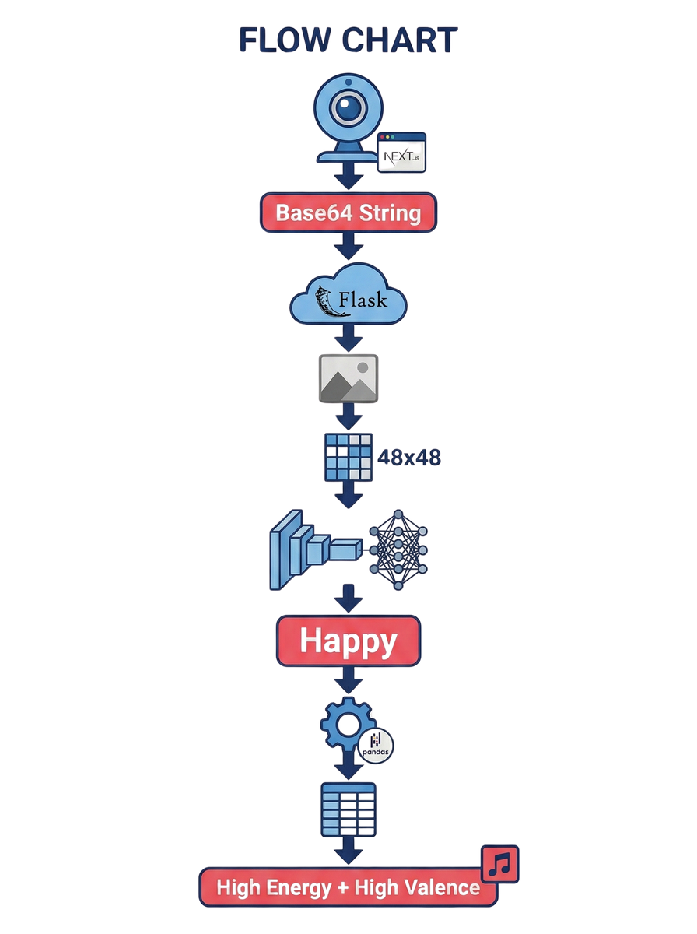
MOODMATE
page 5 of 16
01
STEP 1: IMAGE CAPTURE (FRONTEND)
Next.js captures live video frame → Base64 string.
02
STEP 2: PREPROCESSING API (BACKEND)
Flask receives data → Grayscale → Resize (48 x 48).
METHODOLOGY & PIPELINE
03
STEP 3: CNN INFERENCE (AI MODEL)
VGG-style model predicts label (e.g., "Happy").
04
STEP 4: MUSIC MAPPING (LOGIC)
Pandas engine filters in-memory CSV (e.g., Happy = High Energy + High Valence).
www.tinyurl.com/moodmate

Slide 6
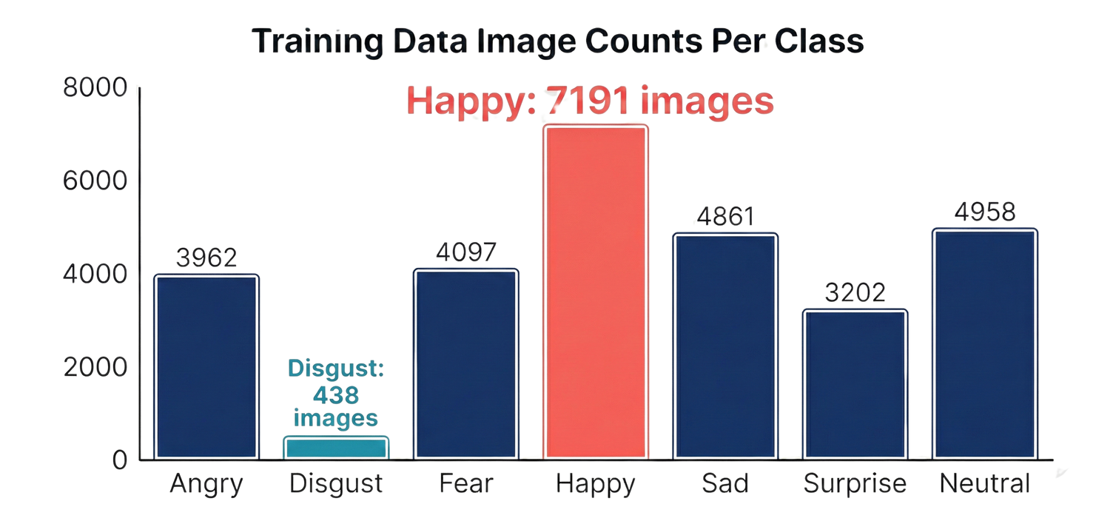
MOODMATE
page 6 of 16
VISUALIZATION & KEY INSIGHTS:
Class Imbalance: "Happy" is dominant (~25%), "Disgust" is rare (~1.5%).
Impact: Necessitated Data Augmentation (rotation/zoom) to prevent bias.
DATA COUNTS:
Happy: ~8,900 images
Neutral: ~6,000 images
Disgust: ~550 images (The Engineering Challenge)
Angry: ~5,000 images
Fear: ~5,200 images
Sad: ~6,100 images
Surprise: ~4,000 images
EXPLORATORY DATA ANALYSIS
www.tinyurl.com/moodmate

Slide 7
MOODMATE
page 7 of 16
GRAYSCALE CONVERSION
NORMALIZATION
ONE-HOT ENCODING
Reduces noise (lighting/skin tone). Forces model to learn structural features (mouth curve, eyebrows).
Converted categorical labels into probability vectors for Softmax.
Example: Happy → [0, 0, 0, 1, 0, 0, 0]
Pixel values 0-255 scaled to 0-1. Accelerates gradient descent convergence.
DATA PREPROCESSING
www.tinyurl.com/moodmate

Slide 8
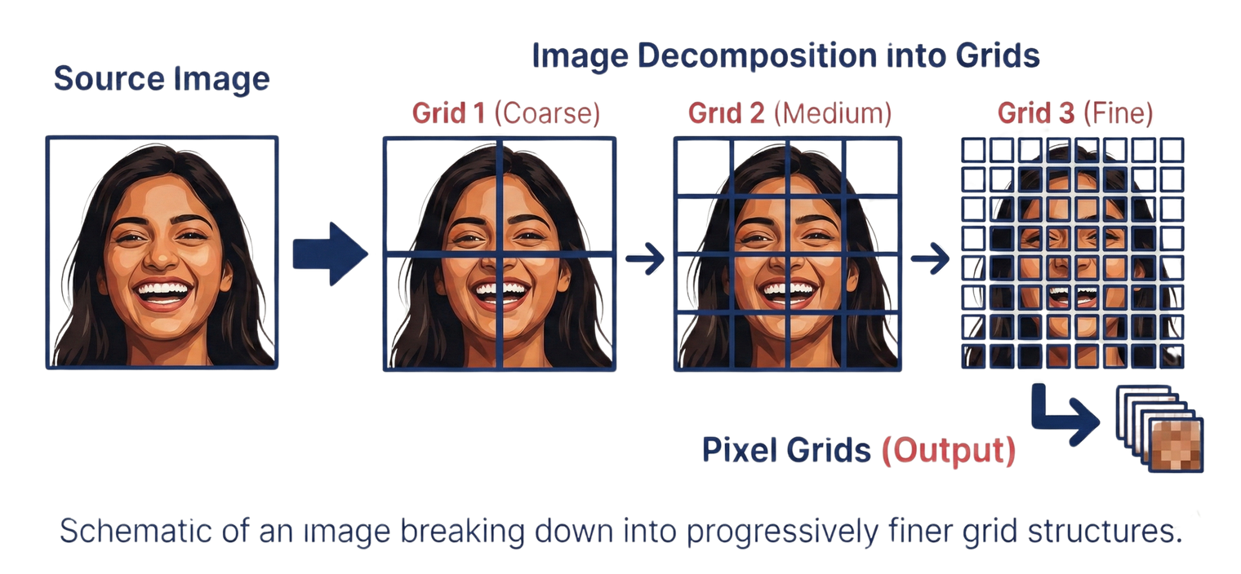
MOODMATE
page 8 of 16
SPATIAL HIERARCHY:
Early Layers: Detect simple edges/lines.
Deep Layers: Detect complex shapes (open mouth, furrowed brow).
MAX POOLING:
Reduces spatial dimensions: 48 x 48 → 24 x 24 → 12 x 12.
Retains "dominant" features while reducing computational cost.
FEATURE EXTRACTION
www.tinyurl.com/moodmate

Slide 9
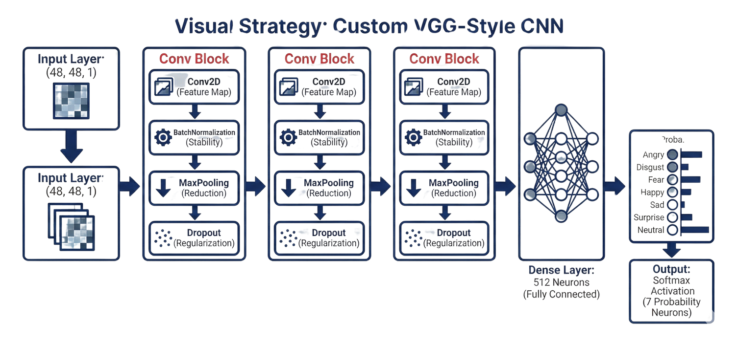
MOODMATE
page 9 of 16
CUSTOM VGG-STYLE CNN
Input Layer: (48, 48, 1).
Conv2D Blocks: 4 sequential blocks containing:
Conv2D (Feature Map)
BatchNormalization (Stability)
MaxPooling (Reduction)
Dropout (Regularization)
MODEL ARCHITECTURE
Dense Layer: 512 Neurons (Fully Connected).
Output: Softmax Activation (7 Probability Neurons).
www.tinyurl.com/moodmate

Slide 10
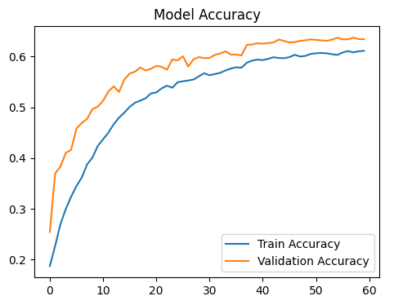
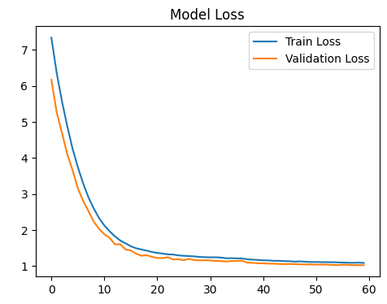
MOODAMATE
page 10 of 16
TRAINING STRATEGY:
Split: 80% Training / 20% Validation.
Optimizer: Adam (Adaptive Learning Rate).
TRAINING & EVALUATION
Callbacks: EarlyStopping (Overfitting prevention).
Metrics: Smooth convergence curve indicating stable learning; latency optimized to <200 ms.
www.tinyurl.com/moodmate

Slide 11
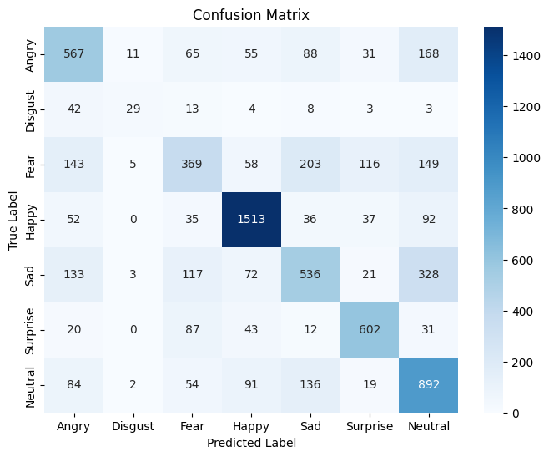
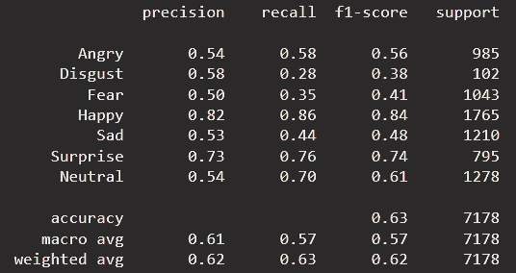
MOODMATE
page 11 of 16
RESULTS COMPARISON
KEY FINDINGS:
High Performance: "Happy" and "Surprise" classes achieved F1-Scores >0.80.
Confusion Corridors: Slight model confusion between "Fear" and "Surprise" attributable to similar geometric facial features (widened eyes/open mouth).
www.tinyurl.com/moodmate

Slide 12

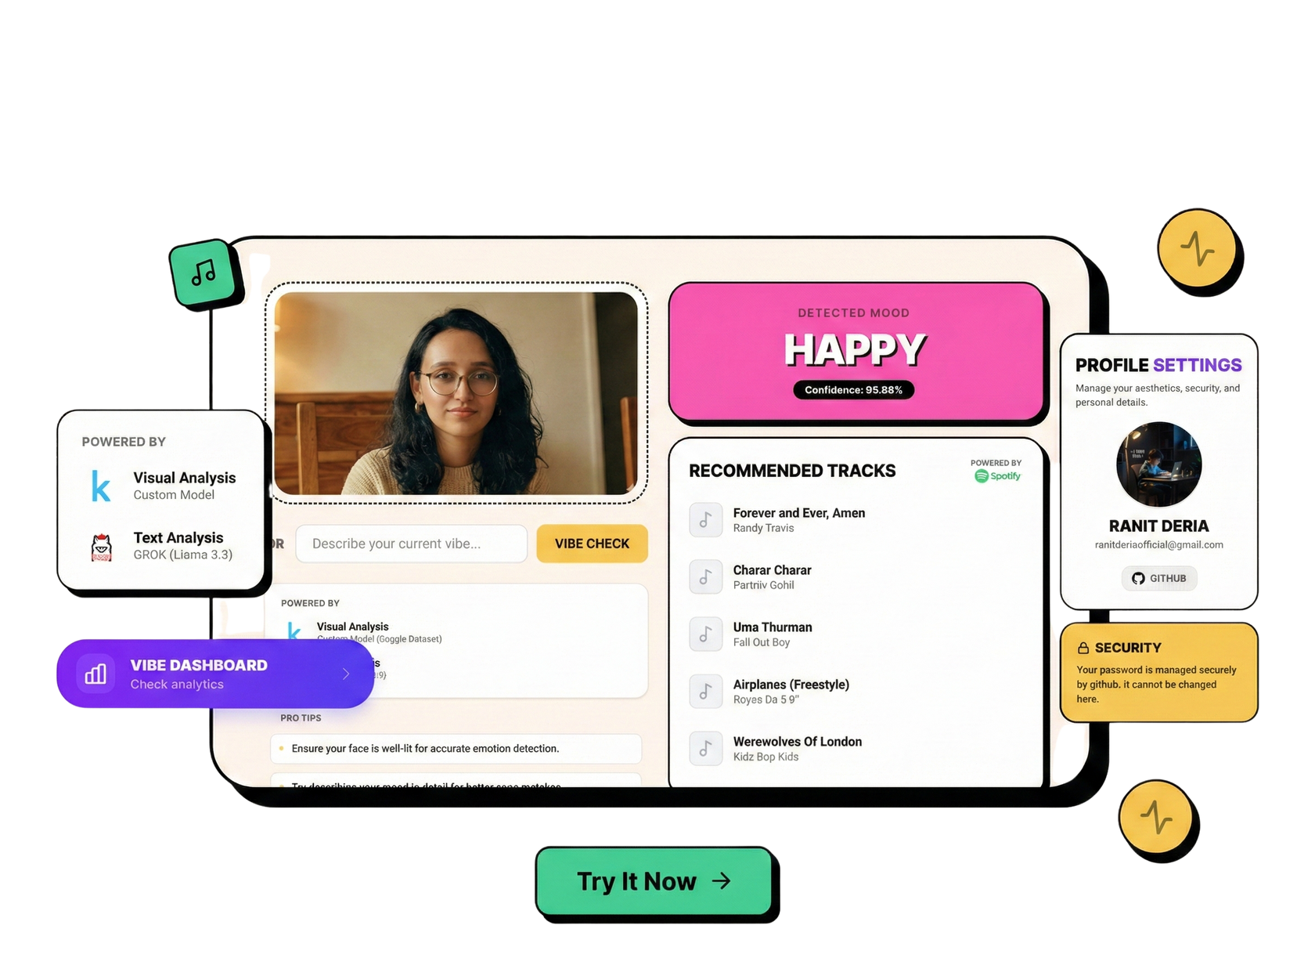


MOODMATE
page 12 of 16
Frontend: Next.js (React Framework) for server-side rendering and swift state management.
SYSTEM INTEGRATION (UI)
Backend: Flask (Python) serving the serialized Keras model via REST API.
Aesthetic: "Glassmorphism" UI with “Neobrutalism” theme to match the cinematic vision.
www.tinyurl.com/moodmate

Slide 13
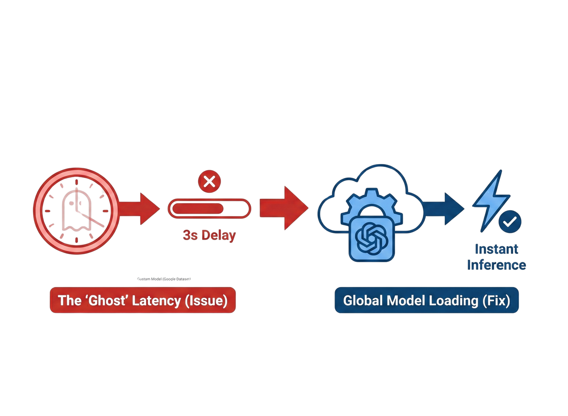
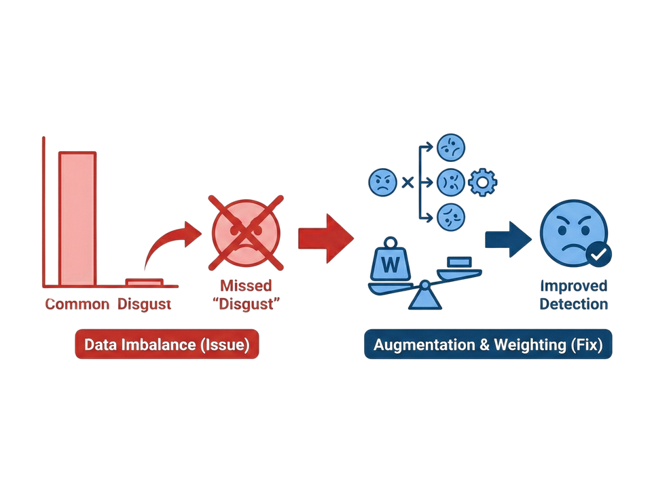
MOODMATE
page 13 of 16
Data Imbalance
The "Ghost" Latency
Issue: Model failure to detect "Disgust" due to lack of training data.
Fix: Applied heavy Data Augmentation and Class Weighting during training.
Issue: 3-second delay caused by reloading the Keras model on every API request.
Fix: Implemented Global Model Loading, initializing the model once at startup for instant inference.
CHALLENGES & SOLUTIONS
www.tinyurl.com/moodmate

Slide 14
MOODMATE
page 14 of 16
01
02
03
Sonic Aura
Implementation of Three.js to generate 3D particle fields reacting to emotion confidence levels.
Community Vibe
Users can collaborative emotion-tagging features on platforms to share multifaceted playlists that transition between different moods and emotional states.
LLM Context
Integration of Llama-3 to generate cinematic "Scenario" descriptions that match the detected mood.
FUTURE SCOPE
www.tinyurl.com/moodmate

Slide 15
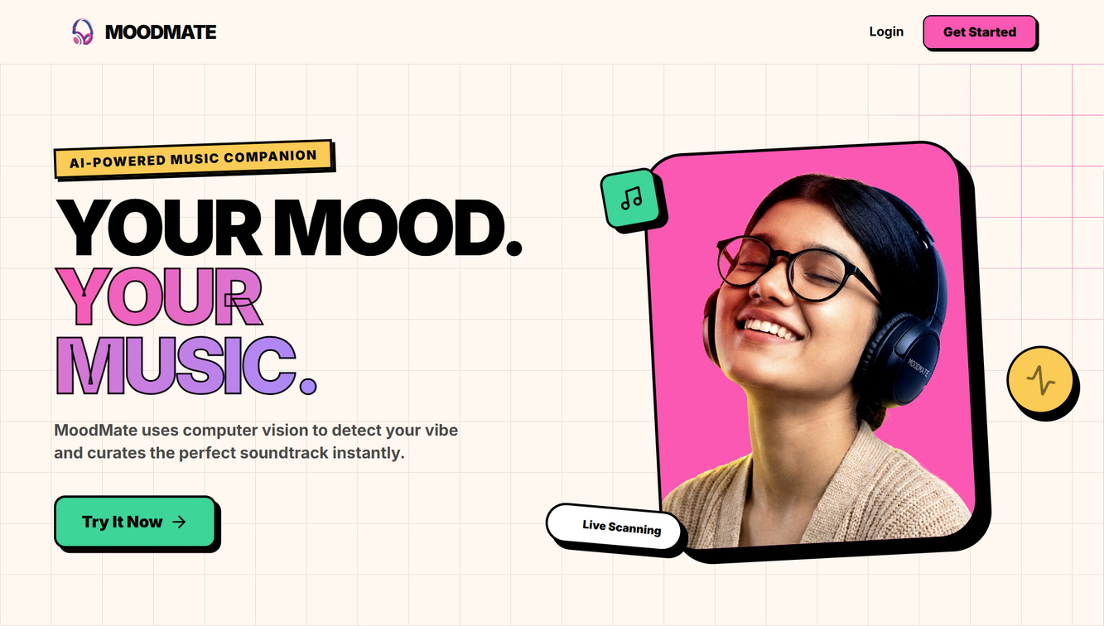
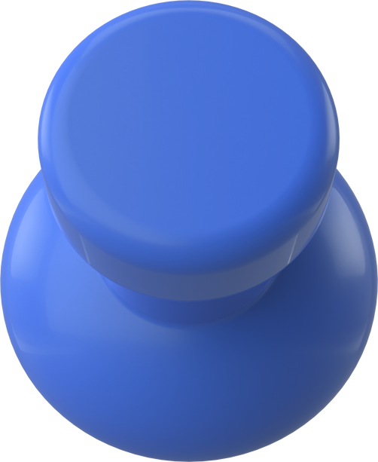
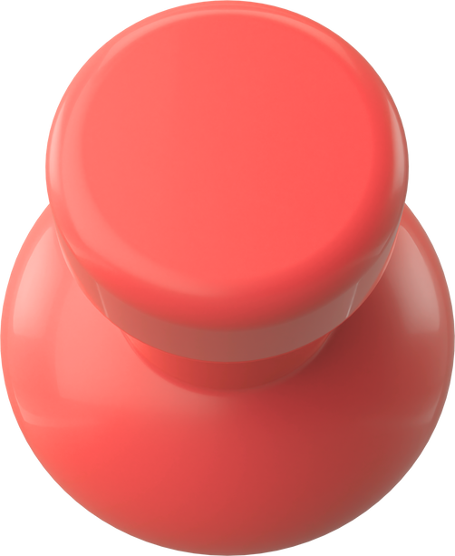
MOODMATE
page 15 of 16
MOODMATE successfully bridges the gap between Deep Learning and modern Web Engineering.
CONCLUSION
Demonstrates a move beyond static classification to a reactive, real-time system.
Validates proficiency in the full data lifecycle: Raw Pixels → Trained Model → Deployed Application.
www.tinyurl.com/moodmate

Slide 16



MOODMATE
page 16 of 16
ACKNOWLEDGEMENT
I extend my sincere gratitude to Infosys Springboard for the opportunity to participate in the Virtual Internship 6.0. Their invaluable mentorship, comprehensive learning resources, and platform support were instrumental in the success of this project and my professional growth.
RANIT DERIA
AI-Augmented Full-Stack Engineer
B.Tech (CSE), 2026
ranitderia.tech
bytebardderia
RanitDERIA
ranit-deria
DeriaRanit
www.tinyurl.com/moodmate

